Slide 1
Module 3: Manage orders and the product catalog with Dynamics 365 Sales

Slide 2
Module agenda
Manage and organize your product catalog with Dynamics 365 Sales
Process sales orders with Dynamics 365 Sales

Slide 3
Lesson 1: Manage and organize your product catalog with Dynamics 365 Sales

Slide 4
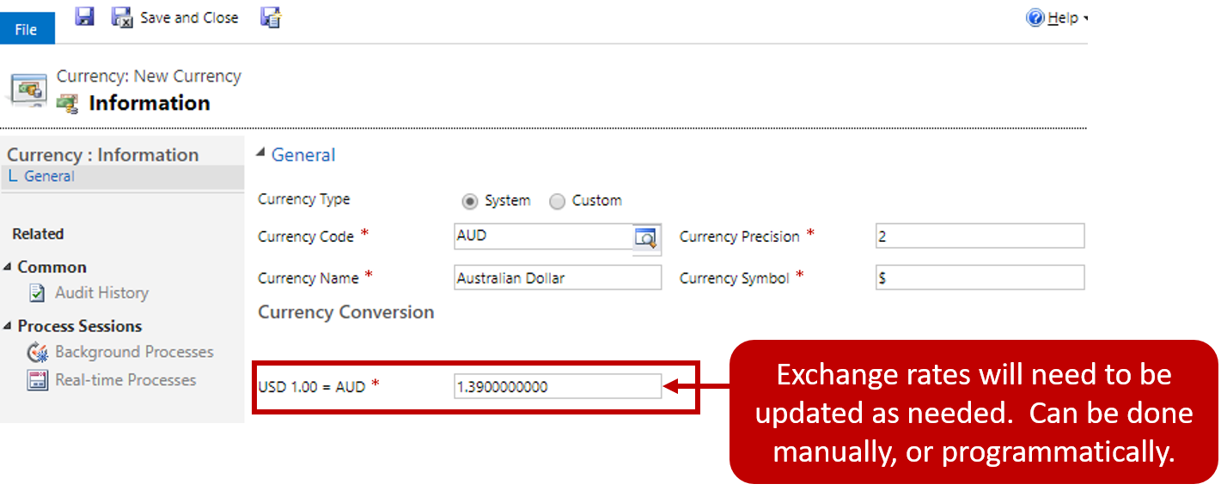
Manage currencies

Slide 5
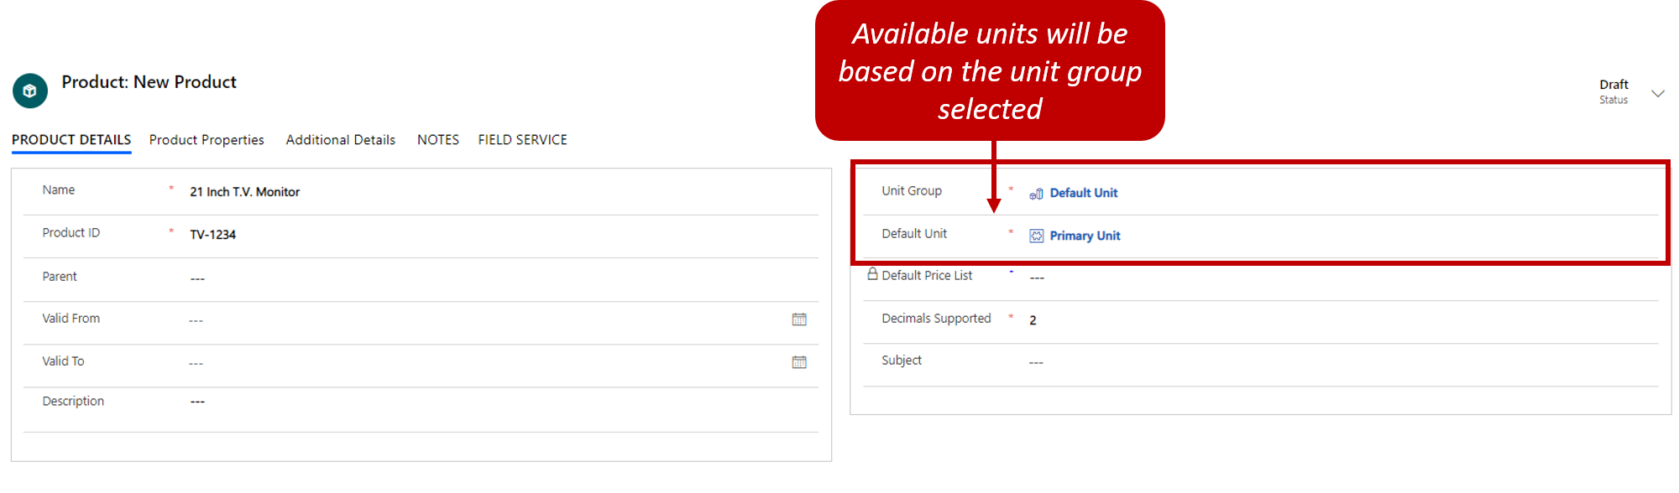
Define products

Slide 6
Product lifecycle
Create
Revise
Revert
Clone
Retire

Slide 7
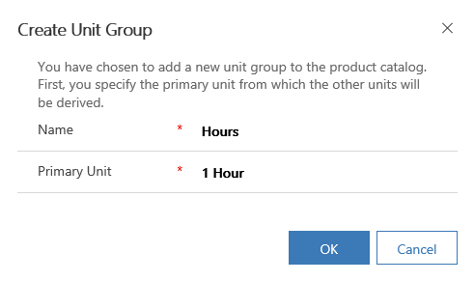
Unit groups
Provides unit of measurement for counting products and associating pricing
Primary unit group: Base unit and lowest common unit of measure that a product can be sold in
Example: A technician bills their time in multiples of 15 minutes, the primary unit group.
Additional units can also be added
Notes:
A unit group provides the unit of measurement for counting products and associating pricing. For example, if the product is bottles of lemonade the primary unit group would be one bottle with additional units for a six pack of bottles, a twelve pack of bottles and a case of 24 bottles. Unit Groups are a required component of the product catalog and must be created before other features can be configured. The configurations for Unit Groups are found in the App Settings area under Unit Groups.

Slide 8
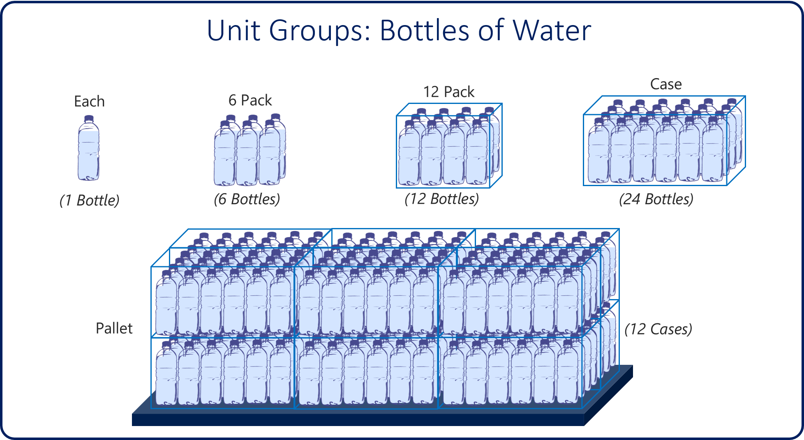
Unit groups

Slide 9
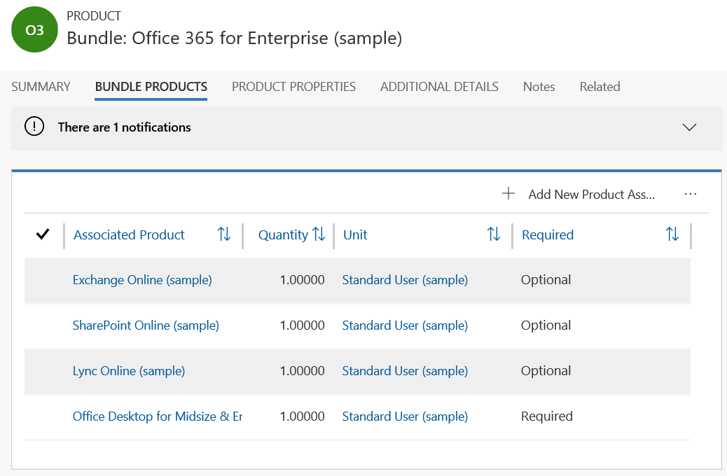
Product families
Grouped products that are in the same category
Can use clone option to create a bundle from an existing bundle
Can add default price list and product associations
Notes:
When creating a bundle of products, you can decide if certain products must be included and give special pricing for the bundle. You can set a total price and a discounted price for the bundle or if the bundle has optional products, add those products to the price list as price list items.
Product bundles can be created from an existing bundle by selecting the clone option. You must save the product bundle before you can add a default price list and product associations. Product bundles replace the deprecated Kit functionality.

Slide 10
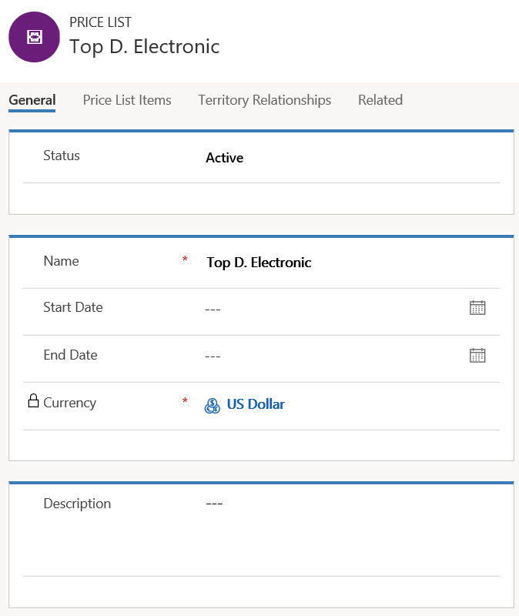
Price lists and discounts
Associates price with product
A single product can be associated with multiple price lists
Price lists are associated with opportunities, quotes, orders and invoices
Discount lists: Optional child record offering bulk discounts
Notes:
The price list associates the price with the product. A single product may be associated with multiple price lists. Price lists are used on opportunities, quotes, orders, and invoices and support system calculated revenue tracking. Price lists can also be associated with marketing lists and can be used in multiple currency environments. You may have one price list or several, whichever suits your organization’s needs. For example, you may have a retail price list, a wholesale price list, and a clearance price list.
Discounts lists are an optional child record that can be associated with a price list. Discount lists are not directly associated with individual products but associated through the price list. Discounts lists can be used to offer bulk discounts when a high volume of a product is purchased.
Individual products are associated to a price list by the creation of a price list item record. A product can be associated to multiple price lists.
Price Lists and Discount lists are found in the App Settings area of the Sales Hub. Price list items are a child record of a price list.

Slide 11
Lesson 2: Process sales orders with Dynamics 365 Sales

Slide 12
Sales order processing overview
Quote: Formal offer for products and services
Order: Confirmed request for delivery of goods
Invoice: Order that has been billed to the customer
Opportunity
Quote
Order
Invoice
Notes:
A video demo is available at the following link: https://youtu.be/66jGsmM3PYM
You may show the video above, or you may use this demo as an example and provide students with a live demo in your personal environment. Please be aware that the video is publicly hosted on YouTube.
To sell effectively, salespeople must know what interactions have occurred with a customer, what touch points have taken place, and what must happen next. Proactively reaching out to customers helps move the sale forward. Phone calls, emails, and meetings are important interactions. For sales people to have a complete view of the opportunity, they must track the various activities that take place with the customer. Dynamics 365 for Sales, users can record and relate different types of activities as an opportunity moves through the various stages of the order cycle from opportunity to Invoice.
When an opportunity is sufficiently progressed you may need to raise a quote and send this to the customer so they can confirm acceptance of the terms and details of the opportunity communicated so far in the process. With Dynamics 365 for Sales you have the ability to create many different quotes tracked to a single opportunity. This offers you the ability to work out different potential pricing models to help ensure that you can close the opportunity as won!
An accepted quote can become an order, indicating that the customer has accepted the terms of the quote and want to progress.
Depending on the way your system is setup, at this point the order may be integrated to another system such as a Finance system or ERP to manage the process from this point forward.
The final step of the process within in Dynamics 365 for Sales in Invoice, where and invoice can be raised or tracked and sent to the customer.
Depending on the way your system is setup, at this point the invoice may be integrated to another system such as a Finance system or ERP to manage the process from this point forward.

Slide 13
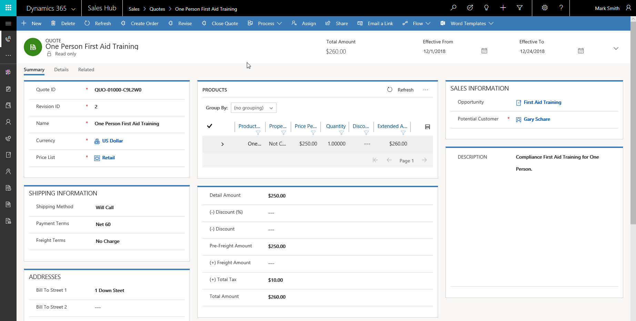
Quote overview
Quotes: Inform customers about the products and prices associated with an opportunity
Notes:
A video demo is available at the following link: https://youtu.be/ew-WfaVVqBs
You may show the video above, or you may use this demo as an example and provide students with a live demo in your personal environment. Please be aware that the video is publicly hosted on YouTube.
Sales representatives can use quotes to inform potential customers about the products and prices associated with a sales opportunity. Customers receive the quote and evaluate it against their budget and needs. If it is a match, then the customer comes back with an acceptance and places an order for the product or service based on the terms in the quote. Otherwise, there are further negotiations until acceptable terms are reached. Quotes can be the integration points between the two solutions; for example, the Dynamics 365 Sales quote might pick up the customer information from Dynamics 365 Sales and pick up the product and pricing information from the other system, such as an Enterprise Resource Planning (ERP) system.
Quotes provide customers with the terms of sale, so it is important to capture price, product and service information in quotes. In some cases, an organization may need to capture special information like a tracking number, which should be added to Dynamics 365 Sales as a custom field.
In some scenarios a quote can become a legally binding document. Once a quote is activated, it becomes read-only. To make changes to it, you must place it back into a draft state to make the edits, then activate it again.

Slide 14
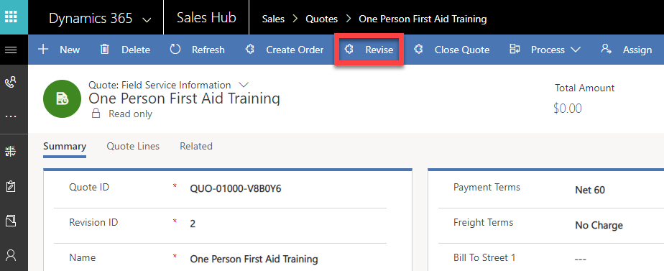
Quote lifecycle
Create a quote
Revise a quote

Slide 15
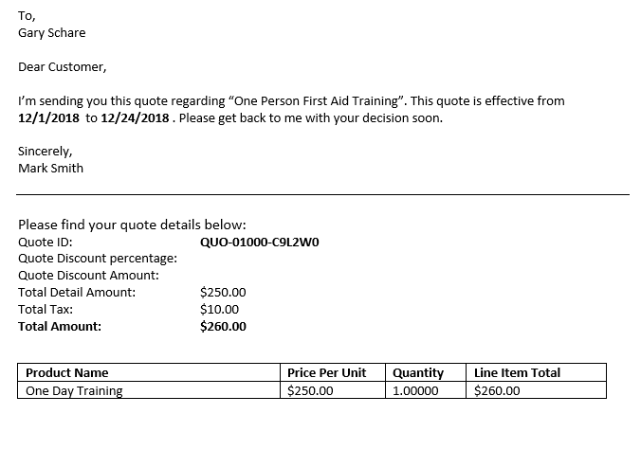
Send quotes
Activate quote from “Draft” to “Active” status before sending
Can use Word templates to print or save as a PDF and distribute to customer

Slide 16
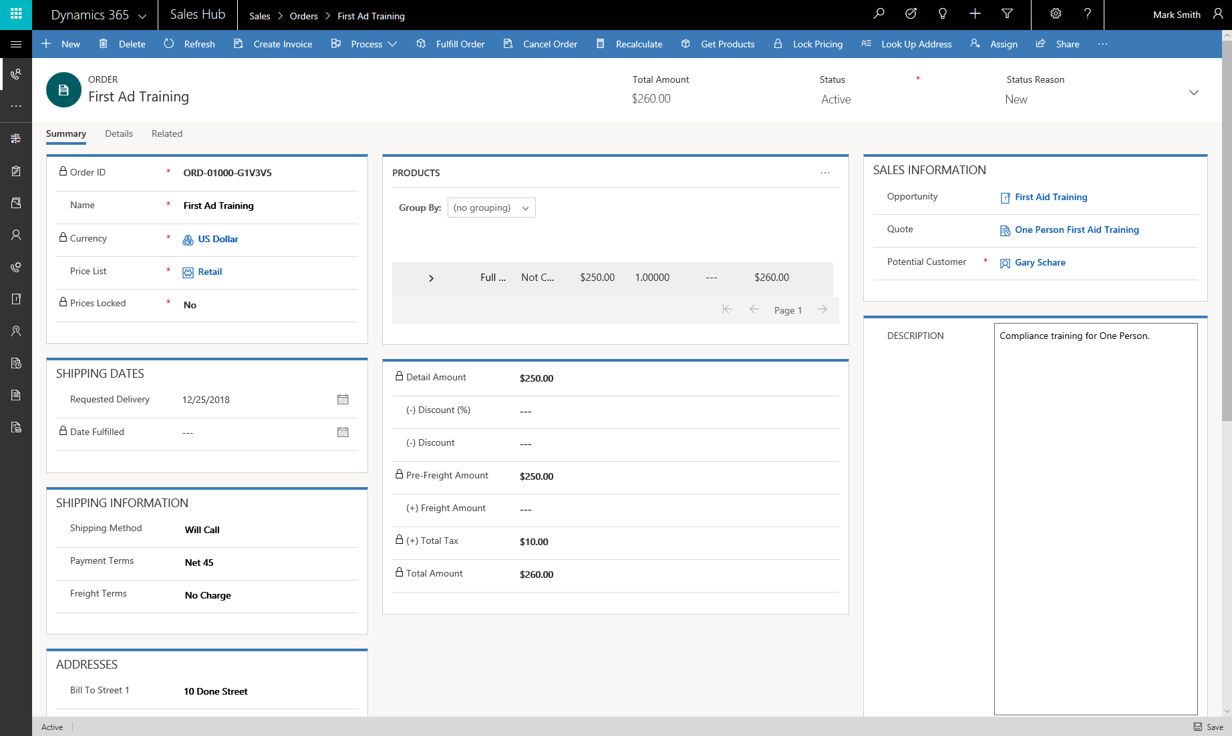
Orders
Can be created automatically from accepted quotes
Allows order to be traced through the sales lifecycle, all the way back to opportunity and lead
Notes:
A video demo is available at the following link: https://youtu.be/vnHgUAW0tO4
You may show the video above, or you may use this demo as an example and provide students with a live demo in your personal environment. Please be aware that the video is publicly hosted on YouTube.
When customers confirm requests for the product or service, a sales representative can then create an order. Organizations receive and process orders that eventually convert to invoices and revenue at the time of shipment.
Dynamics 365 for Sales offers functionality to record customer orders, which can also be created automatically from quotes that have been accepted. This allows an order to be traced back to the opportunity and lead from which it originated.
After the order is placed, it needs to be fulfilled. Organizations often have a fulfillment system in place that Dynamics 365 for Sales needs to integrate with. Alternatively, the user can enter a fulfillment status in Dynamics 365 for Sales to track it in the system.
Information about an order must include the Name, Currency, Price List and Potential Customer information. Beyond this, the business may have a set of details they want to include, such as discount or promotion codes. These can be added as custom fields to the order record type.

Slide 17
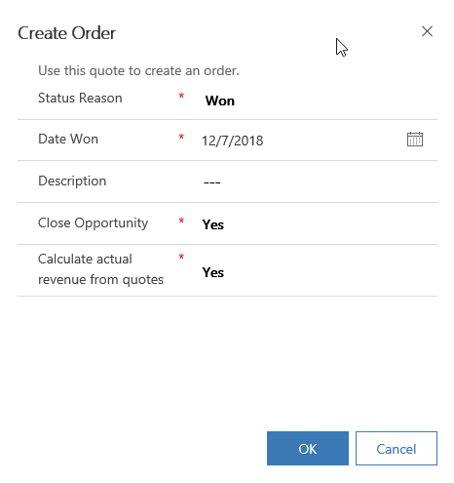
Convert quotes to orders
Clicking “Create Order” on a Quote will populate information into the new Order row
Select:
Status Reason
Date Won
Description
Whether you would like to close the associated Opportunity
Whether you would like to calculate revenue from quote
Notes:
After a salesperson accepts a quote, he or she can generate an order from the quote. The order helps fulfill the agreement of goods or services offered in the quote.
An order is a request from a customer to buy products or services. Typically, an accepted quote leads to an order. However, you can also create an order unrelated to a quote by creating the order from an account, a contact, or an opportunity, and add products to the order. The information you enter is the same on orders generated from quotes or created from the beginning.
Once the order is placed, the next step is fulfillment, which involves providing the services or products that the customer has asked for in the order. Dynamics 365 for Sales allows users to track whether orders have been fulfilled.
Many companies choose to have an order electronically sent to their finances system to be handled from this point forward. However, an Order can also be converted to an Invoice in Dynamics 365 for Sales. It all comes down to how your organization wants to manage the process.

Slide 18
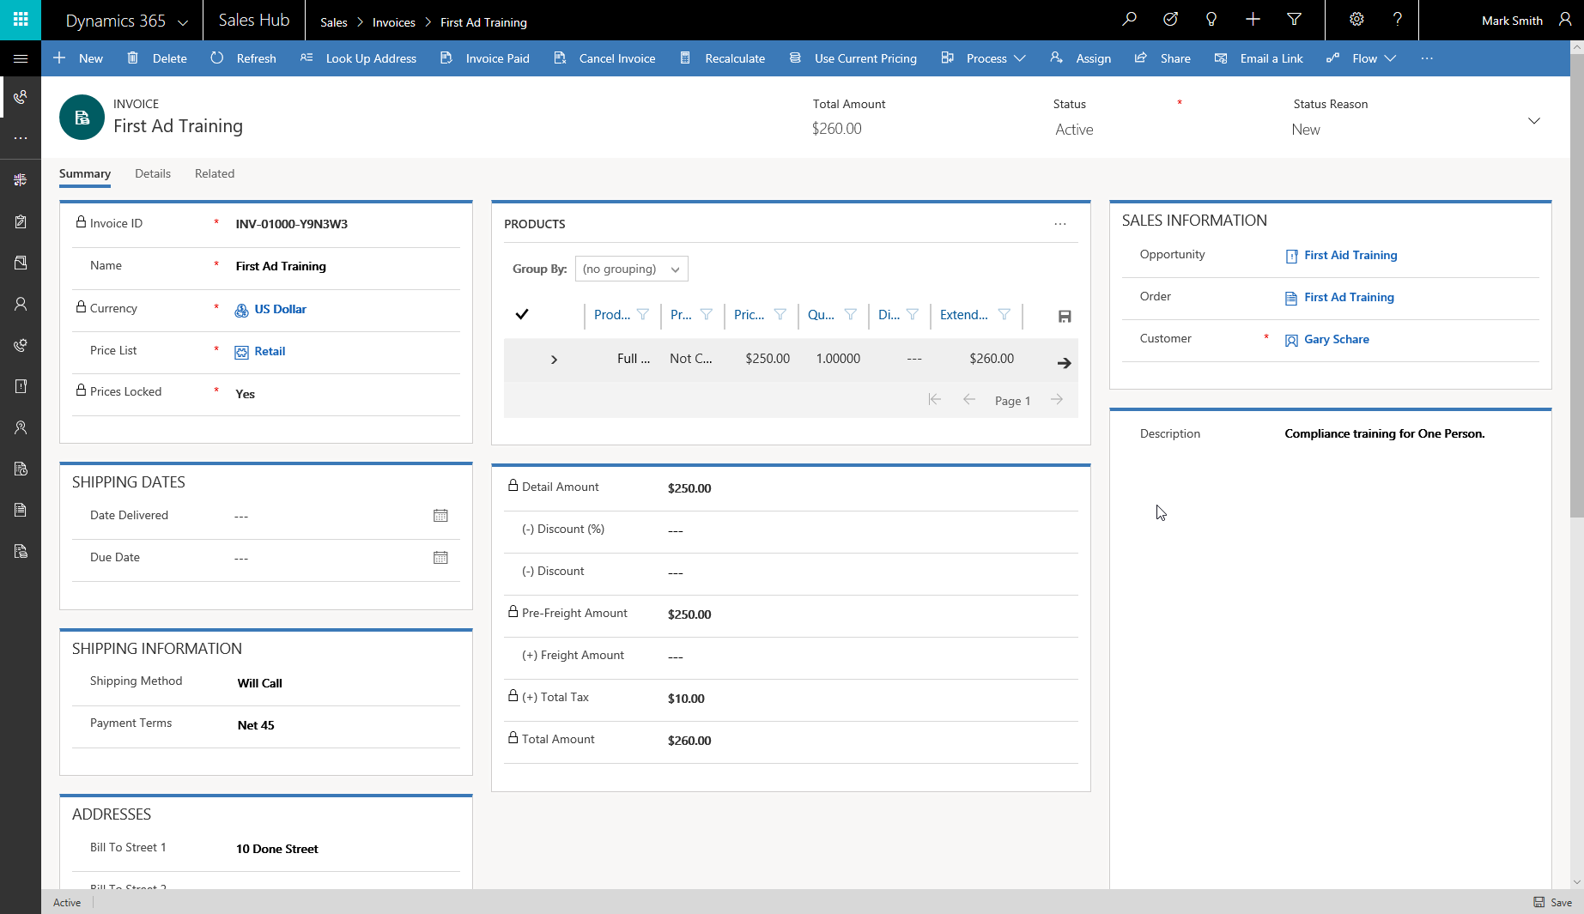
Invoices
Request for payment for an order
Can be created from an order
Notes:
Invoices are requests for payment from a business to its customers. Invoices can be, but are not required to be, related to orders.
Depending on the payment terms, an invoice may be generated from an order after it is fulfilled or when it is placed.
Dynamics 365 for Sales allows users to generate invoices from the system. In many organizations, a separate financial system tracks the invoice payment. In those cases, if an employee uses the solution's Invoice area, he or she must effectively integrate the two systems to keep the data synchronized.

Slide 19
Product catalog overview
Assists with automatic creation of quotes, orders and invoices
Centralizes control over pricing
Presents opportunities for cross-selling and upselling
Create Lead
Qualify
Convert to Opportunity
Create Quote
Create Order
Create Invoice
Notes:
A video demo is available at the following link: https://youtu.be/-7fAcLx-T5U
You may show the video above, or you may use this demo as an example and provide students with a live demo in your personal environment. Please be aware that the video is publicly hosted on YouTube.
The product catalog is NOT a required element
Advantages:
Assist with automatic creation of quotes, orders and invoices
Centralized control over pricing
Cross Selling and Upselling
Sales opportunities associated with products can use System-Calculated Pricing:
Professionals do not have to perform complex manual pricing calculations, which causes less room for error
Information on an opportunity record can be used to automatically create corresponding quote, order, and invoice records, which keeps everything in an organized pattern

Slide 20
Lab 3.1: Manage product catalog Lab 3.2: Build quotes Lab 3.3: Orders and invoices

Slide 21
Closing slide

